Slide 1

CEG’94 Trust
Sponsoring the Dreams of Less Fortunate

Slide 2
Vision
To Give Back to our Society, by helping the Less Fortunate Students of CEG to achieve their Dreams

Slide 3
Mission
Monetary help for the meritorious and needy students to pay Tuition Fees & Hostel Fees, irrespective of religion, caste, creed or gender
Non-monetary help in terms of mentoring, career guidance and soft skills development
Connecting our batchmates to the needy students for additional help

Slide 4
Progress
Interactions with CEG Dean and Alumni Association to define shape to our vision
CEG’94 Trust formed as a Charitable Trust
Registered 325/2017 under Indian Trust Act
Office bearers selected
Opened bank account. Started accepting contributions from CEG ‘94 Alumni
Processes & Procedures - Work in progress
Identified first set of beneficiaries

Slide 5
Office Bearers
President: M. Tamilarasan (Civil)
Secretary: R.S. Ramesh (Mech)
Treasurer: V. Purushothaman (ECE)
Trustees: N. Anuradha (Industrial), K.P. Karuvelamuthu (EEE), K. Natarajan (Printing), S. Selvakumar (ECE), R. Senthilkumar (Production), S. Priya (CSE), Sundar (Mining)
Committee Members: R. Kannan (ECE), S.S. Karthikeyan (CSE), Lalitha Jayabalan (CSE), S. Premkumar (Mech), T.S. Revathy (EEE), S. Ganesh (ECE), B. Jaisankar (ECE), Karpagavalli Jaykumar (Industrial), Prakash (EEE), N. Sivakumar (EEE), Srikanth (ECE)

Slide 6
Plan - Monetary
To build initial corpus of 30 lakhs to provide recurring revenue to fund Trust sponsorships
300 batchmates * Rs. 10,000 One Time Contribution
Expected interest – Rs. 2,40,000 per annum
Sponsor up to 8 students*
15K Tuition + 15 K Hostel fees
Indicative. May vary based on needs and funds availability
Contributions in excess of Rs.10,000 made by our batchmates, up to a maximum of 2 lakhs, to be used to fund 2018-19 students

Slide 7
Plan – Non-monetary
Mentor Program
Career Guidance
Soft skills / Interview Preparation
Internships / Placement assistance

Slide 8
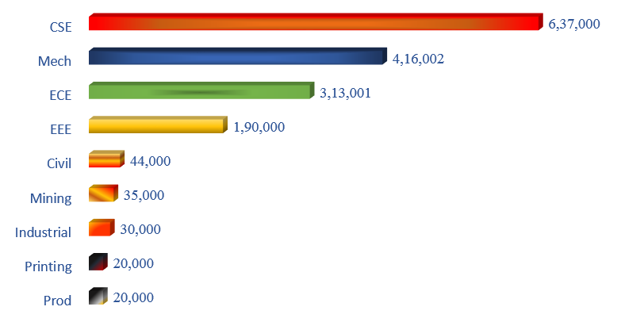
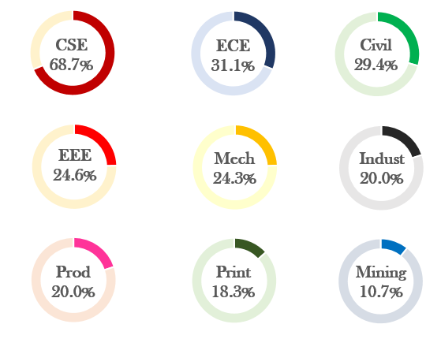
Building the Corpus - Progress
Corpus Collected – 11.97 lakhs / 30 lakhs
0
30%
100%
Contributions towards funding operations for the next 2 academic years: 5,09,003
Departmentwise Contribution:
% of Class Contributed:

Slide 9
Trust Operations
Monthly meeting of Trustees. Larger group invited to brainstorm and formulate policies & procedures
Plan to include Online conference for NRIs to join
Working with CEG, Dean and Alumni Association to identify beneficiaries

Slide 10
A Real Life Warrior needs your Help ….
She lost her father, months before her +2 examination. Mother earns Rs.5,000 per month and struggles to support the family of 4. Still she challenged the odds and scored 1162/1200, with a cut-off of 195.5. Got admission at CEG in 2017. With the help of some well-wishers, she paid her first year fees.
Education is her only savior. Currently she needs help to finish the rest of the course and pursue her dreams.
Students like her need your help. Are you ready?

Slide 11
How can you help?
By contributing to the Corpus
Additional contributions to support needy students in the next academic year (Corpus interest will kick in only after 1 year)
Additional ways to help
Full sponsorship for one student for entire course
Specific sponsorship (Tuition, hostel fees, books, dress for Diwali / Christmas or in any way you think fit)

Slide 12
The Modus Operandi …
Send in your contributions to Trust via Online Transfers / Cheque
Account Name: CEG94 Trust, Account Number: 602205047907
ICICI Bank, R.H. Road Branch, IFSC code: ICIC0006022
Indian passport holders may transfer from their resident savings or NRO accounts
Income Tax exemption u/s 80G shall be made available in future [Dec’18]
Non-Indian passport holder may transfer through a relative or friend holding an Indian passport
Trust shall begin accepting foreign remittances upon receiving further approvals [Mar’19]

Slide 13
Questions
Reach out to info@ceg94trust.org
Visit http://www.ceg94trust.org
Attend one of the Trust meetings

Slide 14
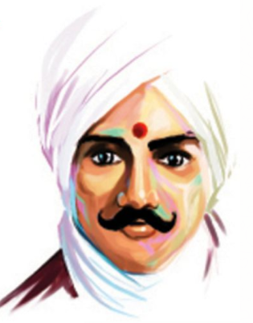

அன்ன சத்திரம் ஆயிரம் வைத்தல், ஆலயம் பதினாயிரம் நாட்டல், பின்னருள்ள தருமங்கள் யாவும், பெயர் விளங்கி ஒளிர நிறுத்தல், அன்னயாவினும் புண்ணியம் கோடி ஆங்கோர் ஏழைக்கு எழுத்தறிவித்தல்
Your Small Contributions Today can Make a
Big Difference to Someone’s Life.

